Slide 1
Variation in Derived Extrasolar Planet Spectrum

Slide 2
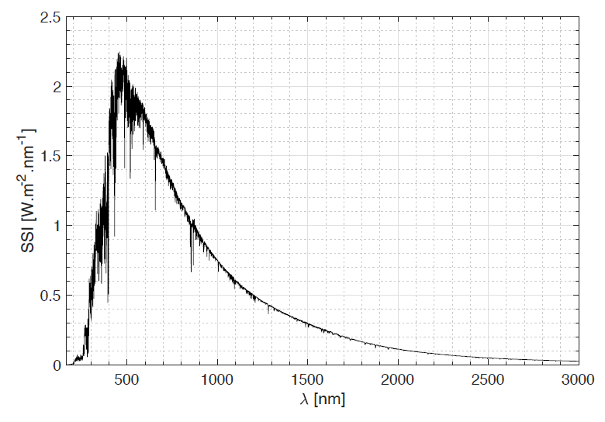
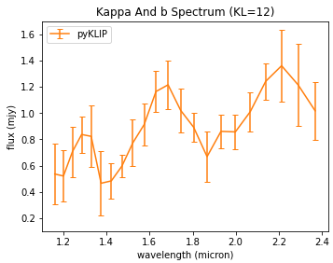
First…
Exoplanets [are] any planets beyond our solar system - NASA
Solar spectrum
flux density (mjy)
https://www.esa.int/ESA_Multimedia/Images/2017/12/Solar_spectrum

Slide 3
Why?
An exoplanet’s spectrum
Can be used to determine the chemical composition of the planet
Can be used to estimate physical quantities of the planet such as surface gravity and temperature
Variation in an exoplanet’s spectrum
Can tell us the actual spectral variation of the planet
Can inform us about various phenomenon such as solar flares
Can even inform us about the planet’s rotation
Can inform us on the current imaging processing capabilities of our spectrum derivation method

Slide 4

CHARIS
CHARIS - Coronagraphic High Angular Resolution Imaging Spectrograph
Integral Field Spectrograph (IFS)
Broadband filter – 1.154 - 2.387 μm in 22 slices
Kappa And b
CHARIS DRP
KLIP-FM
Raw
Reduced data cube
Processed data cube
Kappa And System on Sept. 8, 2017

Slide 5
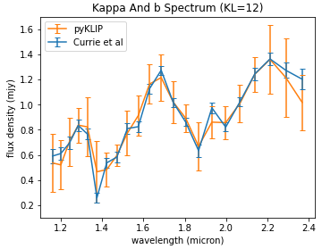
Resulting Spectrum
Our produced spectrum in orange and published result in blue.
Kolmogorov – Smirnov test between reference and our method:
KS statistic = 0.1363
p-value = 0.979
Kappa And System on Sept. 8, 2017

Slide 6
Spectral Variance
1𝝈 is on average 20% of spectrum
A spike in variance at 1.86 μm and a lower spike at 2.37 μm
Kappa And System on Sept. 10, 2017

Slide 7
Future Developments
Resolve large variances at particular wavelengths (the spikes)
Perhaps due to the instrument and bad slices
Perhaps due to the speckle removal processing
Separate the sources of variation
Variation of the planet spectrum itself
Variation of the instrument
Variation of the post-processing algorithm

